Slide 1
Valuing Neighborhoods in Chicago
this project will focus on determining the locations in Chicago that a new home buyer will have the highest likelihood of retaining property value based on the characteristics of the surrounding neighborhood.

Slide 2
Interest
This project will potentially be of interest to:
New Chicago home buyers
Chicago real estate and real estate investment firms
Chicago municipal departments focused in community development
Chicago small business owners

Slide 3
Data
The city of Chicago is divided into 77 Community Areas. These areas can be used as feature groups of different variables to gain insight into the characteristics of the area.
Data Elements
Data Sources
Community Area
Population
Median Household Income
Mortgage Activity Rate
Foreclosure Activity Rate
Poverty Rate
Tree Canopy
Venues and Facilities
Wikipedia.org
HousingStudies.org
Edirepository.org
---Tree Data Citation--- link:https://portal.edirepository.org/nis/mapbrowse?packageid=knb-lter-bes.5008 Citation: Locke, D.H. 2020. Residential housing segregation and urban tree canopy in 37 US Cities;data in support of Locke et al 2020 in npj Urban Sustainability ver 1. Environmental Data Initiative.https://doi.org/10.6073/pasta/907a557cac781eb4cf72f866a2903c04 (Accessed 2021-03-01).
---Housing Data Citation--- link:https://www.housingstudies.org/data-portal/browse/?indicator=poverty-rate&area=chicago-community-areas&view_as=view-table
link:https://www.housingstudies.org/data-portal/browse/?indicator=total-foreclosure-activity&area=chicago-community-areas&property_type=0&view_as=view-table

Slide 4
Data Selection
The selection of these specific elements was done by searching the qualities that new home buyers look for in a neighborhood.
The though being that the higher the income, tree canopy and mortgage activity, the more attractive the neighborhood is to the general population, and subsequently the properties there are more valuable.
The opposite thought being that the higher the foreclosure rate and lower the income and tree canopy, the lower the perceived value of the neighborhood.
The level of foreclosure activity, mortgage activity, population size, income/poverty levels and tree canopy will be the primary clustering set for the neighborhoods.
Note: Chicago is a notoriously violent city, but I have deliberately left out all demographic data and crime statistics (even though I originally included it) to try to level the obvious bias of the clustering.

Slide 5
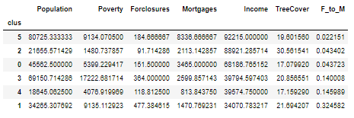
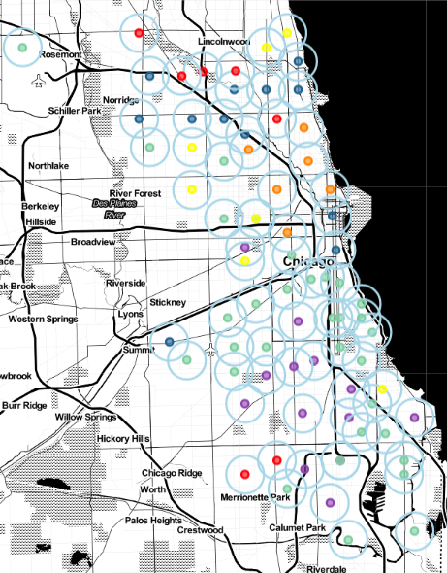
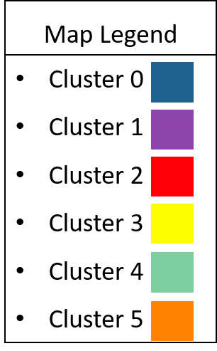
Community Area Clustering
The cluster map on the right shows the six clusters.
Above is a table of the clustering elements averaged for the respective cluster.
This table is sorted on ‘F_to_M’, which is the average Foreclosures to Mortgages ratio for the community areas in the cluster
Highlighted by the divisions in red, it is plain to see there is a large difference between clusters 5,2,0 and 3,4,1.

Slide 6
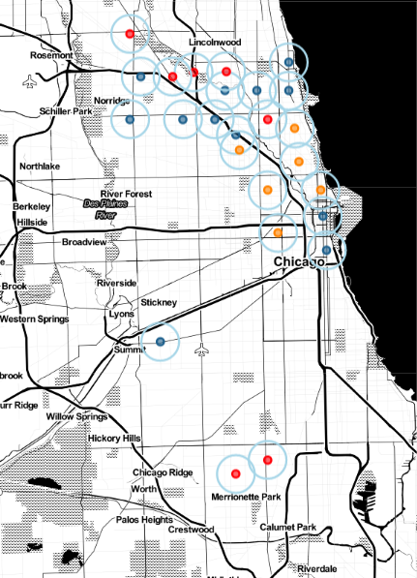
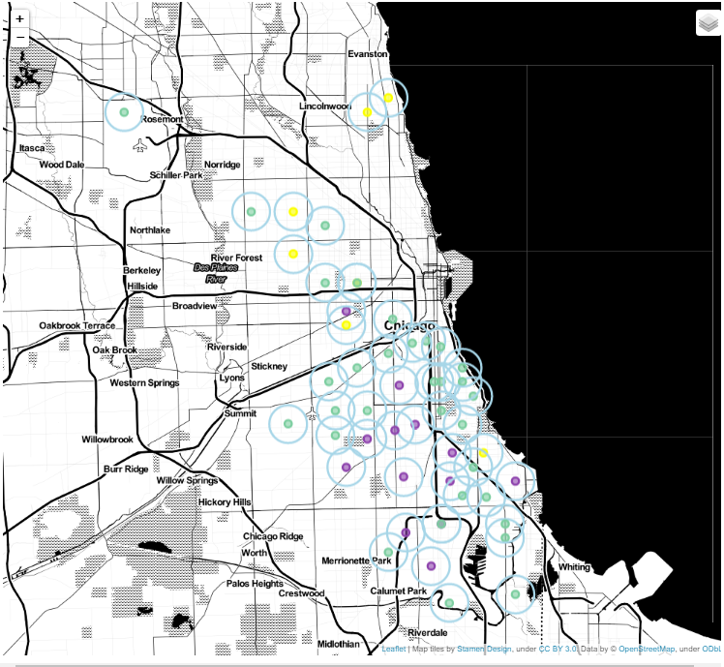
Cluster Analysis
Perceived Higher Value
Perceived Lower Value
Clusters 0 2 5
Clusters 1 3 4
When viewing these as two separate groups of clusters, it is easy to see the geographic separations
Note: It is not surprising that it should be north and south, as Chicago’s south side has a reputation that is notorious worldwide. However the pockets of neighborhoods in the positive grouping that are outside the northern half of the city are interesting, as they show movement to develop new areas of value outside of the established most expensive communities.

Slide 7
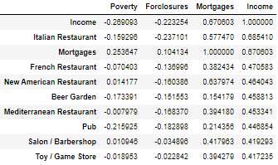
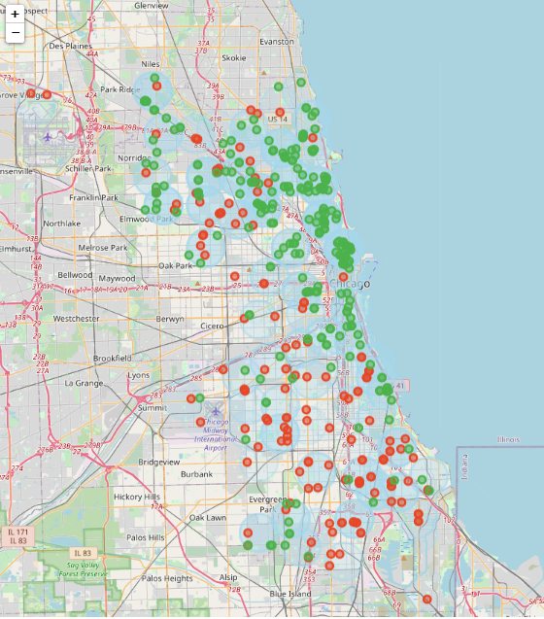
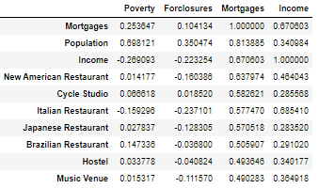
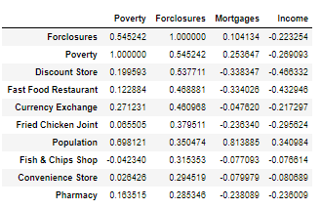
Venues in Community Areas
Three correlation tables below were used to help determine the venue groupings to check. (Sorting Circled in Red)
These tables highlight venue types that show the highest correlation to Income, Mortgages, and Foreclosures respectively.
Highest correlation values, as well obvious positive and negative elements (i.e. playgrounds being positive, factories being negative) were used to create a categorized map to see separations. Positive(green) negative(red).

Slide 8
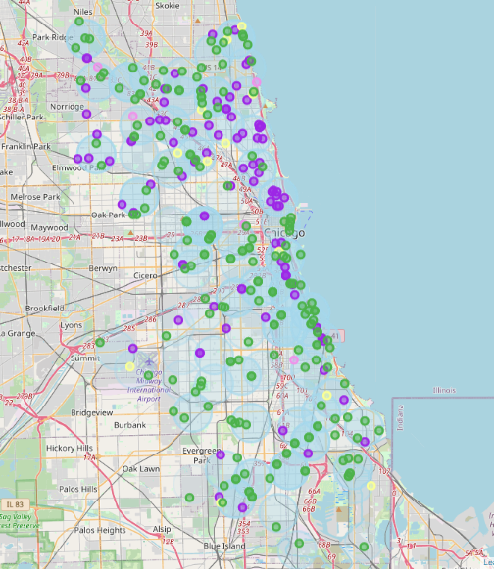
Venues in Community Areas (cont.)
In addition, a similar map was generated to visualize the location distribution of some of the most desirable public facilities and venues.
This included:
Parks(green)
Gym/Fitness Centers(purple)
Playgrounds(yellow)
Dog Parks(pink)
The map to the right shows the location of public parks are plentiful throughout the city of Chicago. However, fitness centers, dog parks and playgrounds have a very skewed distribution to the same three community clusters highlighted earlier (5, 2 and 0).

Slide 9
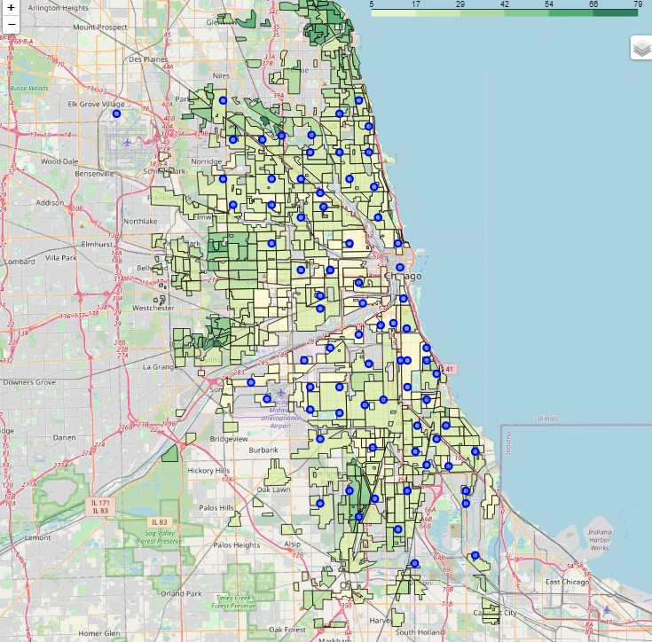
Tree Canopy
Another thing of note is the tree canopy percentages per area
Shown in the map to the right, it is visible that the community areas that average higher income, mortgage rates and have less foreclosures have a higher percentages of tree canopy.
This obviously disregards the city center, as there is not much room for copious amounts of trees in downtown Chicago

Slide 10
Conclusions
The results show that based on the analysis done, that the community areas contained in clusters 5, 2, and 0 will have higher perceived value from the average consumer.
Buying a home in one of these three clusters would have a higher likelihood of appreciating in value than would buying in one of the other three clusters.
This conclusion is based on the communities in clusters 5, 2, and 0 averaging much higher income levels and mortgage activity while being substantially lower in foreclosures relative to the other three clusters.
In addition, and most likely due to the previous, the venues located in these three clusters are indicative of higher neighborhood value, and subsequently higher property values.

Slide 11
Closing Notes
I would like to clarify that this conclusion is drawn from a completely objective and data-based standpoint. If you were to look at the demographic make-up of the clusters, the lower perceived value community areas are home to a much higher percentage of minorities and people of color . Demographics were specifically not used, and the goal was to see houses strictly in the capacity of that of an asset. In order to accurately assess risk and valuation for the specific kind of asset that is property, determining the effect that the asset’s location has is paramount in assuring the best return on invest. In no way shape or form is this project a comment on, or a valuation of; people, culture or community.

